Slide 1

The Canadian Energy Research Institute and
Friends of AIMS Present:
Allan Fogwill
Follow on Twitter @AIMS_CA using the hashtag #AIMSBreakfast

Slide 2


Canadian Energy Research Institute
Greenhouse Gas Emissions Reductions in Canada through Electrification of Energy Services
Allan Fogwill
January 2017
Relevant • Independent • Objective
www.ceri.ca

Slide 3
Canadian Energy Research Institute
Overview
Founded in 1975, the Canadian Energy Research Institute (CERI) is an independent, non-profit research Institute specializing in the analysis of energy economics and related environmental policy issues in the energy production, transportation, and consumption sectors.
Our mission is to provide relevant, independent, and objective economic research of energy and environmental issues to benefit business, government, academia and the public.

Slide 4








Current Sponsors
Supporters include:
In-kind support is also provided:

Slide 5
Introduction
Electrification of end use energy services is seen as a “technology path” to economy wide GHG emissions resections
Manage emissions in hundreds of point sources – not several thousands of distributed emitters (buildings, vehicles, etc.)
Proven technology exists to decarbonize power generation
Such an economy wide energy transition requires:
  changing the existing infrastructure across all sectors of the economy (infrastructure inertia)
  much larger electricity generation and transmission infrastructure than today

Slide 6
Objectives
To assess economic and environmental impacts of electrifying energy end use services in Canada:
  10 provinces
  3 sectors: residential, commercial, passenger transportation
We focus on energy end use services that can be electrified by utilizing commercially ready technologies or ones that can be commercialized within a decade or less

Slide 7
Main Research Questions
Is it technically feasible?
  With proven technologies
What major transitions in the energy systems are required?
What is the scale of emissions reductions that can be achieved through electrification of energy services?
What would it cost?

Slide 8
Method
A stock-rollover model that simulates physical infrastructure
Annual time steps with equipment lifetimes: 2020-2050
Simulate energy consumption at an aggregated level (housing stock, vehicle stock, etc. )
Takes into account infrastructure inertia
Build scenarios to explore emissions reduction options
Notes:
We mainly use a stock-rollover methodology that simulate physical infrastructure
Simulate energy consumption at an aggregated level (housing stock, vehicle stock, etc. )
Build scenarios to explore emissions reduction options

Slide 9
Current Electricity use and emissions
Electricity Share of the Residential Sector Energy Mix in Canadian Provinces, 2014
GHG Emissions Intensity of Electricity Generation
Mix of Canadian Provinces, 2014

Slide 10
Methods: Scenarios
Note - S2 renewable percentage is approximately 10% less than S1
- Different supply scenarios only for AB, SK, ON

Slide 11
Results

Slide 12
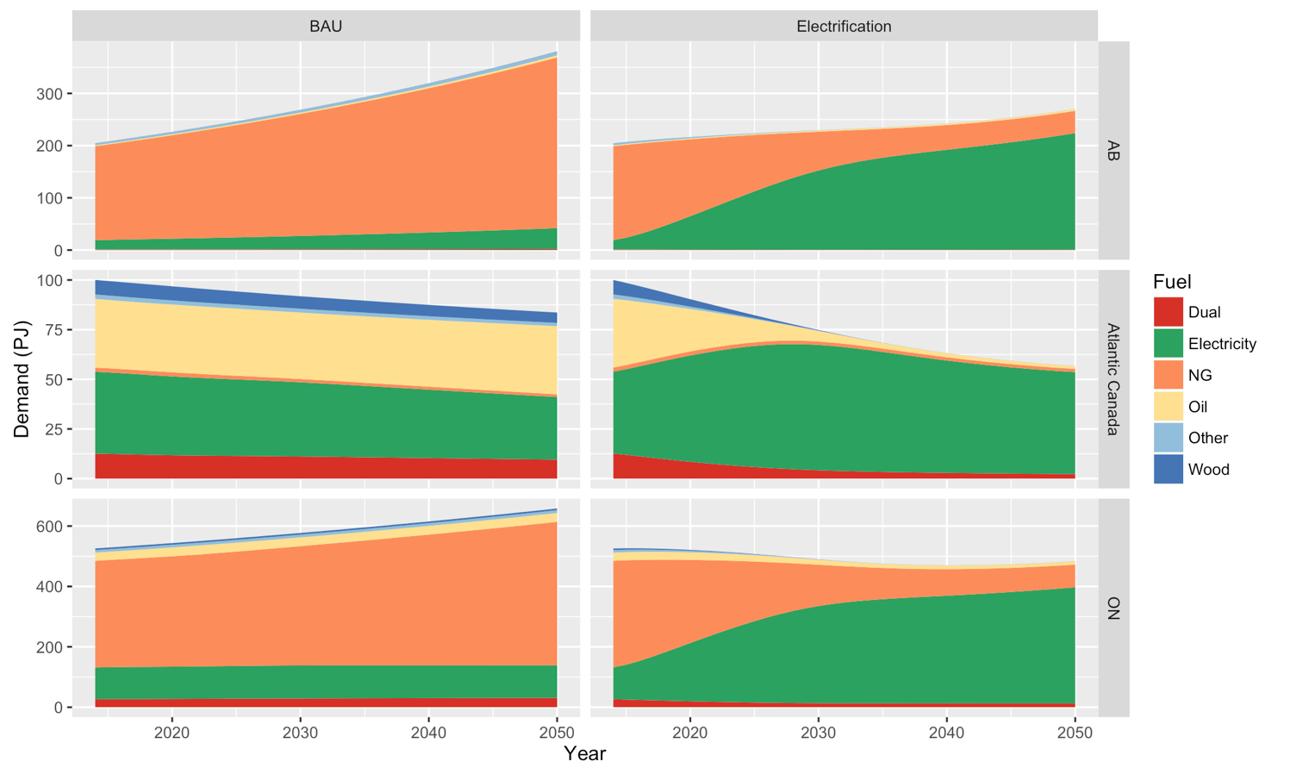
Residential Sector: Fuel demand

Slide 13
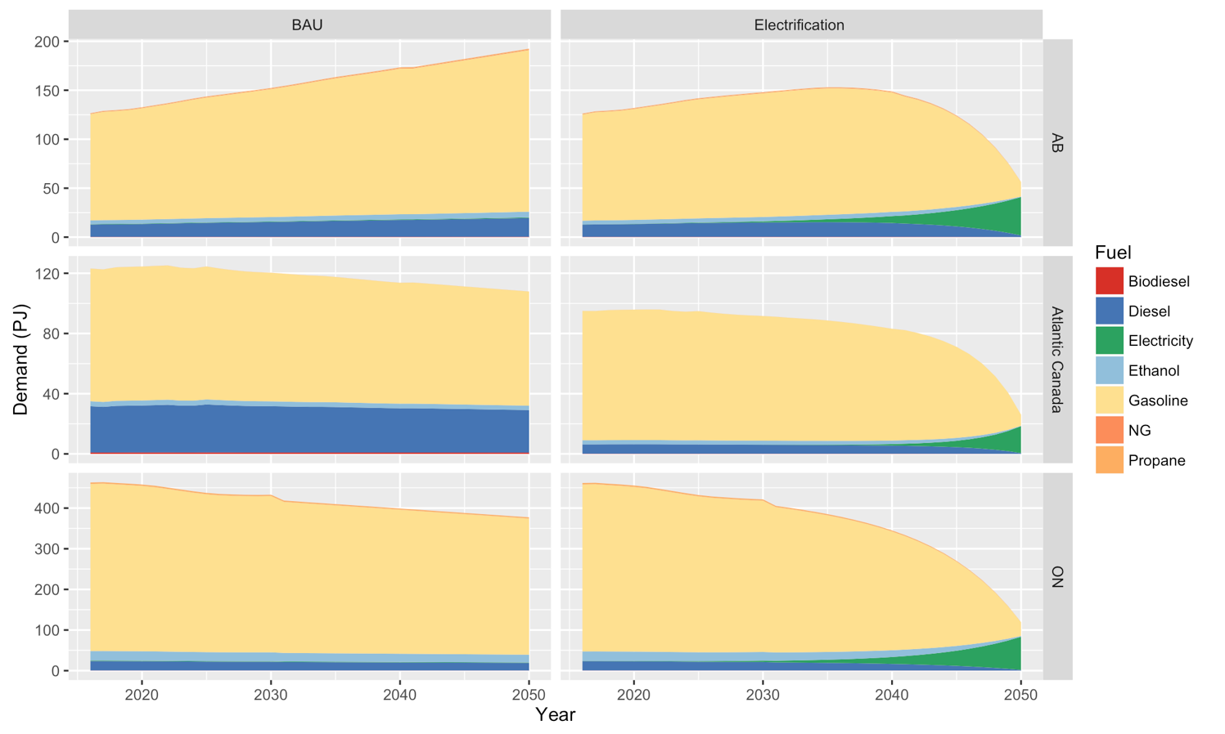
Road Passenger Transportation: Fuel demand

Slide 14
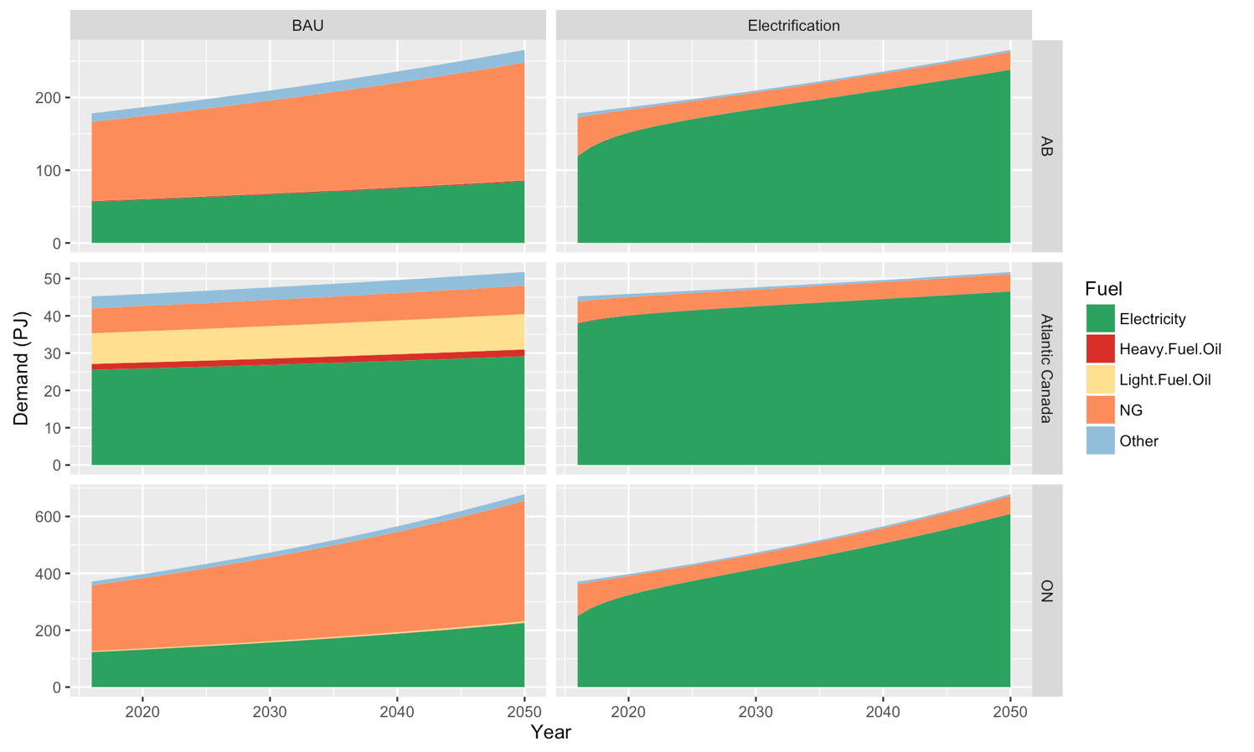
Commercial Sector: Fuel demand

Slide 15
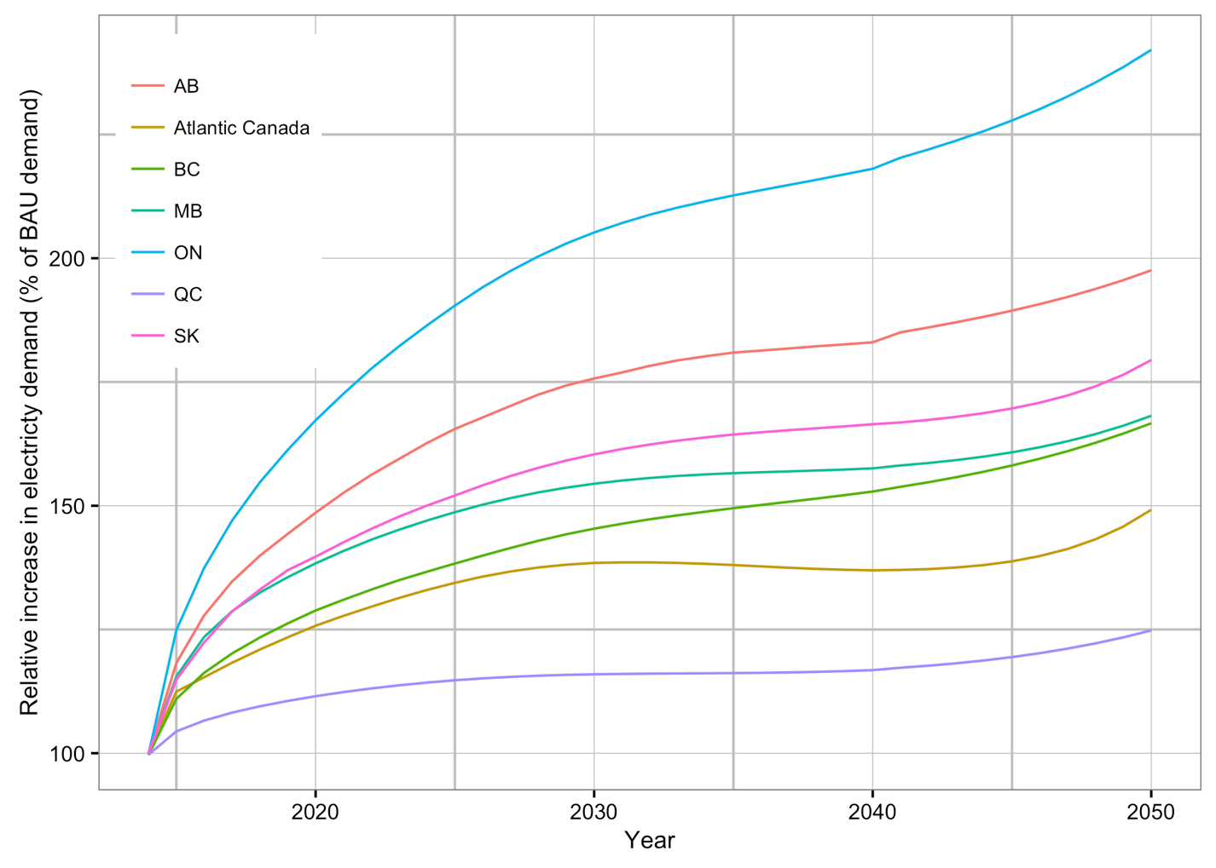
Growth in Electricity Demand

Slide 16
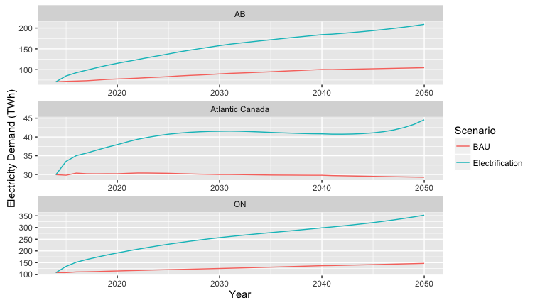
Electricity Demand: Electrified Sectors
x 2 times
x 1.5 times
x 2.5 times

Slide 17
Efficiency Improvements - residential
Energy Intensity including direct fuel combustions and primary energy for electricity (GJ/household)
Region | Year |  | BAU | Electrification | Reduction under electrification
Atlantic Canada | 2030 |  | 85 | 73 | 14%
Atlantic Canada | 2050 |  | 66 | 51 | 24%
Quebec | 2030 |  | 83 | 74 | 11%
Quebec | 2050 |  | 77 | 61 | 21%
Ontario | 2030 |  | 91 | 85 | 7%
Ontario | 2050 |  | 83 | 84 | -1%
Manitoba | 2030 |  | 81 | 73 | 10%
Manitoba | 2050 |  | 75 | 57 | 24%
Saskatchewan | 2030 |  | 96 | 100 | -4%
Saskatchewan | 2050 |  | 83 | 82 | 1%
Alberta | 2030 |  | 117 | 123 | -5%
Alberta | 2050 |  | 133 | 126 | 5%
British Columbia | 2030 |  | 57 | 56 | 3%
British Columbia | 2050 |  | 58 | 57 | 0%

Slide 18
Efficiency Improvements - Transportation
Energy Intensity including direct fuel combustions and primary energy for electricity (MJ/Pkm)
Region | Year |  | BAU | Electrification | Reduction under electrification
Atlantic Canada | 2030 |  | 1.75 | 1.75 | 0.2%
Atlantic Canada | 2050 |  | 1.73 | 0.68 | 60.8%
Quebec | 2030 |  | 1.93 | 1.85 | 4.3%
Quebec | 2050 |  | 1.96 | 0.65 | 66.8%
Ontario | 2030 |  | 1.85 | 1.80 | 2.6%
Ontario | 2050 |  | 1.85 | 0.92 | 50.1%
Manitoba | 2030 |  | 2.24 | 2.19 | 2.1%
Manitoba | 2050 |  | 2.19 | 0.67 | 69.6%
Saskatchewan | 2030 |  | 2.05 | 2.04 | 0.3%
Saskatchewan | 2050 |  | 2.05 | 0.90 | 56.1%
Alberta | 2030 |  | 1.97 | 1.92 | 2.7%
Alberta | 2050 |  | 1.97 | 0.79 | 59.9%
British Columbia | 2030 |  | 1.92 | 1.84 | 4.3%
British Columbia | 2050 |  | 1.92 | 0.74 | 61.6%

Slide 19
Emissions & Cost

Slide 20
GHG Emissions relative to 2005 Benchmark
 | In 2030 | In 2050
Atlantic Canada | 7% | 13%
Quebec | 9% | 35%
Ontario | 14% | 31%
Manitoba | 11% | 24%
Saskatchewan | 8% | 16%
Alberta | 6% | 16%
British Columbia | 9% | 16%
Target - 2030 – 30% below benchmark
- 2050 – 80% below benchmark

Slide 21
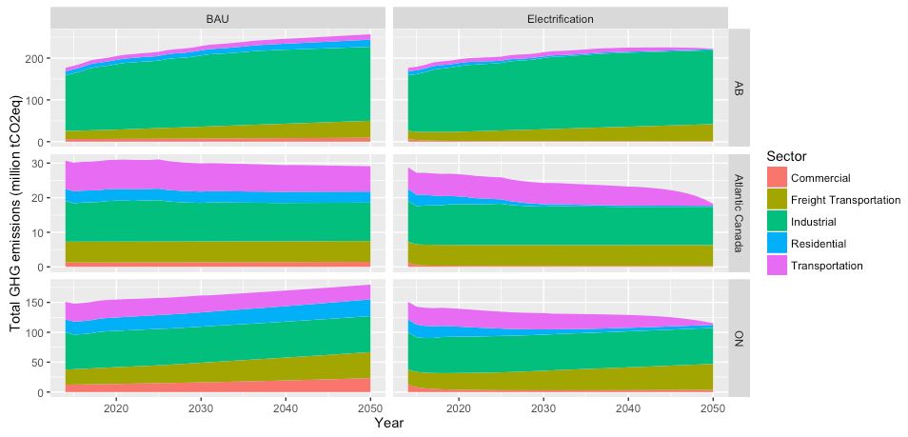
GHG Emissions: All Demand Sectors
Majority of demand side emissions are from non electrified sectors (i.e.. industrial, freight transportation)

Slide 22
What Would it Cost (in Alberta)?
By 2050, Under electrification scenario, electricity generation infrastructure is 2 times that of BAU scenario
Scenario | Demand side | Electricity supply | Cumulative cost of electricity¹ (billion 2014 CAD) | Cumulative GHG emissions² (million tCO2eq) | Cost of avoided GHG emissions³ (CAD/tCO2eq) | Increase in average cost of electricity in 2050 (% of S0)
S0 | Not electrify | BAU | 108 | 7551
S1 | Electrify | High renewables | 244 | 7016 | 216 | 28%
S2 | Electrify | High renewables + GAS CCS | 234 | 6994 | 176 | 33%
¹ Cumulative cost of adding new capacity and operating electricity infrastructure in the period of 2020-2050
² In the period of 2020-2050
³ Calculated by taking into account capital cost of demand side mitigation measures and fuel cost savings.
Notes:
0.4%/ year
0.9%/ year

Slide 23
What Would it Cost (in Ontario)?
By 2050, Under electrification scenario, electricity generation infrastructure is 2.4 times that of BAU scenario
Scenario | Demand side | Electricity supply | Cumulative cost of electricity¹ (billion 2014 CAD) | Cumulative GHG emissions² (million tCO2eq) | Cost of avoided GHG emissions³ (CAD/tCO2eq) | Increase in average cost of electricity in 2050 (% of S0)
S0 | Not electrify | BAU | 117 | 5144
S1 | Electrify | High renewables | 366 | 4074 | 124 | 77%
S2 | Electrify | High renewables + GAS CCS | 352 | 4101 | 114 | 77%
¹ Cumulative cost of adding new capacity and operating electricity infrastructure in the period of 2020-2050
² In the period of 2020-2050
³ Calculated by taking into account capital cost of demand side mitigation measures and fuel cost savings.
Notes:
0.4%/ year
0.9%/ year

Slide 24
What Would it Cost (in Atlantic Canada)?
By 2050, Under electrification scenario, electricity generation infrastructure is 1.5 times that of BAU scenario
Scenario | Demand side | Electricity supply | Cumulative cost of electricity¹ (billion 2014 CAD) | Cumulative GHG emissions² (million tCO2eq) | Cost of avoided GHG emissions³ (CAD/tCO2eq) | Increase in average cost of electricity in 2050 (% of S0)
S0 | Not electrify | BAU | 29 | 909
S1 | Electrify | High renewables | 54 | 764 | 14 | 48%
S2 | Electrify | High renewables + GAS CCS | No change
¹ Cumulative cost of adding new capacity and operating electricity infrastructure in the period of 2020-2050
² In the period of 2020-2050
³ Calculated by taking into account capital cost of demand side mitigation measures and fuel cost savings.
Notes:
0.4%/ year
0.9%/ year

Slide 25
Concluding Remarks
Electrification provides a viable option to decarbonize residential, commercial, and passenger transportation sectors with current technologies
Industrial sector remains the most significant contributor – we did not assess mitigation measures
Electrification will profoundly transform the physical energy system
Level of end-use energy services remains relatively unchanged

Slide 26
Concluding Remarks
Viability of electrification as an emissions reduction measure depends largely on decarbonizing the power sector
  Coal to standard gas transition is not sufficient
Availability Gas CCS lowered the abatement cost and total cost in Alberta
Deeper reductions require mitigation measures in the industrial sector, freight transportation and further decarburization of the electricity sector

Slide 27

Canadian Energy Research Institute
Thanks for coming!
Thank you for your time
www.ceri.ca
Canadian Energy Research Institute on LinkedIn
Twitter @ceri_canada
Check out this and our other studies
on CERI’s website
Allan Fogwill
afogwill@ceri.ca
587.225.7605
Follow our work at AIMS.ca/Beacon
Follow the Canadian Energy Research Institute at CERI.ca

